Slide 1
Java Reader class
Reader
BufferedReader
CharArrayReader
FilterReader
InputStreamReader
PipedReader
StringReader
Reader class is an abstract class for reading character streams.

Slide 2
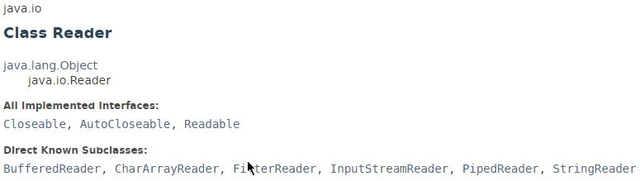
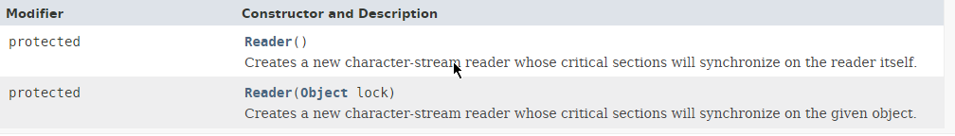
Java Reader class

Slide 3
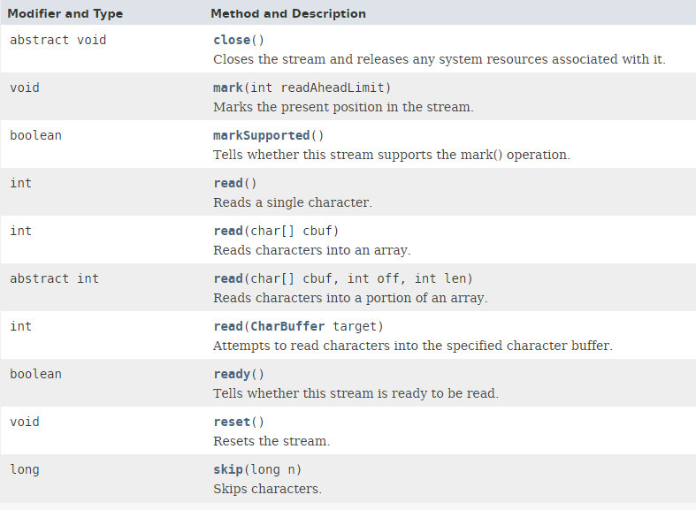
Java Reader class

Slide 4
Java Reader class
https://docs.oracle.com/javase/8/docs/api/index.html?java/io/Reader.html

